Slide 1
Diagnosis and Management of celiac disease in adults
Dr Seyed Farshad Allameh
Tehran University of Medical Sciences

Slide 2
Diagnosis of celiac disease
Celiac disease is a small bowel disorder characterized by mucosal inflammation, villous atrophy, and crypt hyperplasia, which occur upon exposure to dietary gluten and demonstrates improvement after withdrawal of gluten from the diet.

Slide 3
Serologic testing for celiac disease is recommended in adults with any of the following:
Suggestive gastrointestinal symptoms:
Gastrointestinal symptoms include chronic or recurrent diarrhea or constipation, malabsorption, unexpected weight loss, abdominal pain, distension, or bloating. Testing should therefore be performed in patients with symptoms suggestive of irritable bowel syndrome or refractory lactose intolerance.
Extraintestinal signs/symptoms suggestive of celiac disease:
This includes patients without other explanations for iron deficiency anemia, folate or vitamin B12 deficiency, persistent elevation in serum aminotransferases, dermatitis herpetiformis, fatigue, recurrent headaches, recurrent fetal loss, low birthweight offspring, reduced fertility, persistent aphthous stomatitis, dental enamel hypoplasia, metabolic bone disease and premature osteoporosis, idiopathic peripheral neuropathy, or nonhereditary cerebellar ataxia.

Slide 4
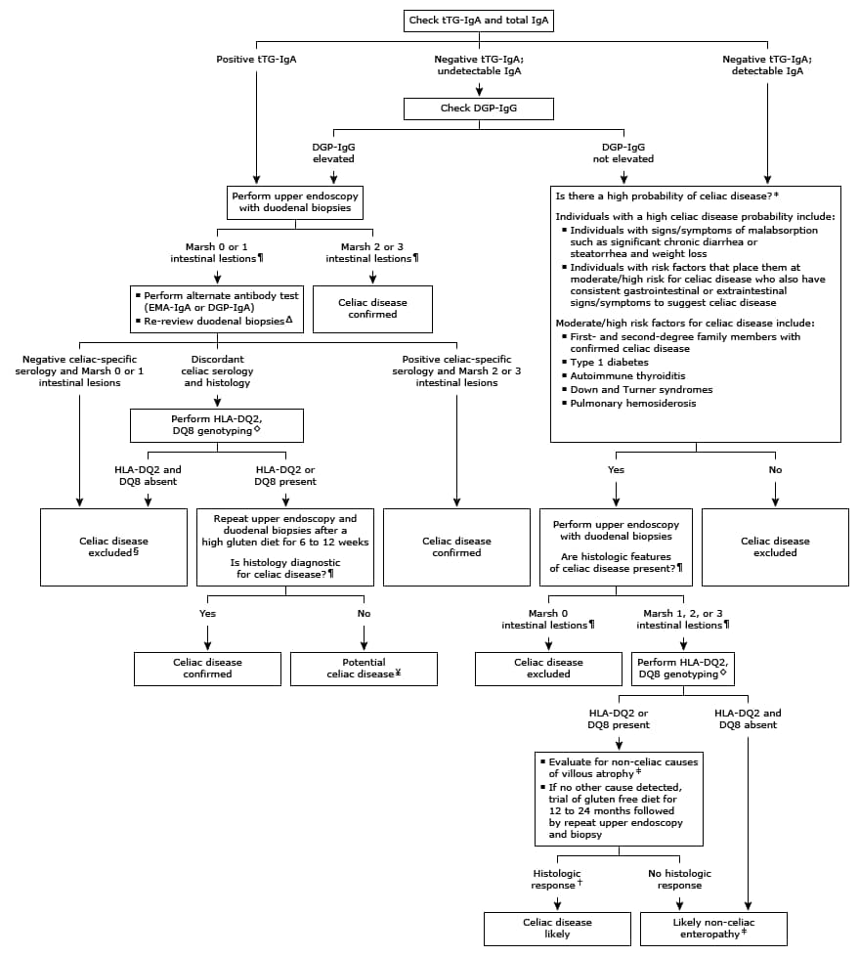

Slide 5
The diagnosis of celiac disease in patients with biopsy-proven dermatitis herpetiformis can be established by serology alone without a small bowel biopsy.
The most common disorders in the differential diagnosis of celiac disease include: irritable bowel syndrome, small intestinal bacterial overgrowth, lactose intolerance, chronic pancreatitis, microscopic colitis, and inflammatory bowel disease.
Non-celiac gluten sensitivity (NCGS) describes a syndrome of symptomatic response to gluten ingestion in patients with no serologic or histologic evidence of celiac disease.

Slide 6
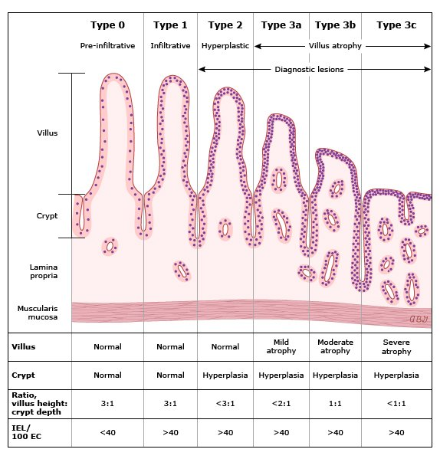

Slide 7
In individuals at low risk for celiac disease, evaluation begins with serologic testing. Patients with positive serologic testing, should undergo an upper endoscopy with small bowel biopsy to diagnose celiac disease. In contrast, in individuals with a high probability of celiac disease, both serologic testing and small bowel biopsy should be performed.
Immunoglobulin A (IgA) anti-tissue transglutaminase (tTG) antibody is the single preferred test for detection of celiac disease in adults. In addition, we concurrently measure total IgA levels. In patients with IgA deficiency we perform IgG-based testing with deamidated gliadin peptide (DGP) IgG.

Slide 8
The diagnosis of celiac disease is established by the presence of increased intraepithelial lymphocytes with crypt hyperplasia (Marsh type 2) alone, or in conjunction with villous atrophy (Marsh type 3) on small bowel biopsy in a patient with positive celiac serology.
In patients with celiac disease and discordant serology and biopsy results, the intestinal biopsy should be re-reviewed by a pathologist familiar with celiac disease to look for subtle abnormalities of celiac disease.
In addition, perform an alternate antibody test (EMA-IgA or DGP-IgA). If serology and histology remain discordant, also perform HLADQ2/DQ8 typing to guide additional evaluation.

Slide 9
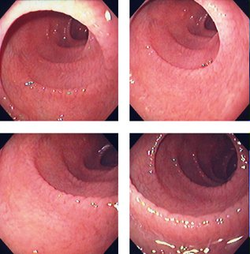

Slide 10
Management of celiac disease
As a general rule, there are six key elements in the management of patients with celiac disease, which can be summarized with the following acronym :
Consultation with a skilled dietitian
Education about the disease
Lifelong adherence to a gluten-free diet
Identification and treatment of nutritional deficiencies
Access to an advocacy group
Continuous long-term follow-up by a multidisciplinary team

Slide 11
DIETARY COUNSELING
The principal sources of dietary gluten are wheat, rye, and barley
Soybean, rice, corn, potatoes are safe.
Medications (pills) generally contain minimal gluten and do not need to be avoided.

Slide 12
Approximately 70 percent of patients have noticeable clinical improvement within two weeks.
We suggest that patients be evaluated four to six weeks following the initiation of a gluten-free diet at which time a complete blood count, folate, B12, iron studies, liver chemistries, and serologic testing should be performed.

Slide 13
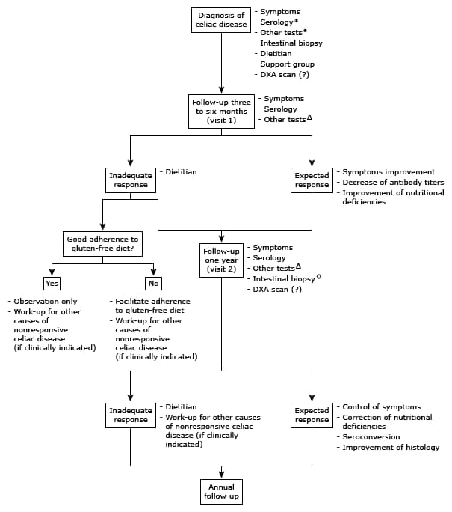

Slide 14
IgA anti tissue transglutaminase (tTG) or IgA (or IgG) deamidated gliadin peptide (DGP) should be used to monitor the response to gluten-free diet.
Perform serologic testing 6 and 12 months after the initial diagnosis of celiac disease and annually thereafter.
The need for a follow-up biopsy in patients with clinical improvement has been debated, especially since serologic testing can be used to monitor recovery and compliance with the diet.

Slide 15
The consensus is that re-biopsy should be undertaken four to six months after commencing a gluten-free diet to confirm the diagnosis and a satisfactory response to the diet.
In patients with persistent Marsh 2 or more severe histologic lesions on re-biopsy, a follow-up upper endoscopy with biopsy should be performed in 12 months.
An upper endoscopy with biopsy should also be performed in patients with established celiac disease who fail to respond to a gluten-free diet or with relapse of symptoms despite a gluten-free diet.

Slide 16
Repletion of nutritional deficiencies
Patients should be tested for deficiency of vitamins (A, D, E, B12), copper, zinc, carotene, folic acid, ferritin, iron, and prothrombin time (PT) measured for potential vitamin K deficiency.
Deficiency in thiamine, vitamin B6, magnesium, and selenium may also occur depending on the disease severity and dietary intake and should be tested for in the presence of clinical signs or symptoms of a deficiency.
A gluten-free diet may induce troublesome constipation. This usually responds to fiber supplementation with psyllium seed husks.
There may be incomplete absorption of medication in untreated, partially treated, or refractory celiac disease. This is important for women of childbearing age who take oral contraceptive pills.

Slide 17
Bone loss (principally osteopenia and less often osteoporosis) is common in celiac disease, and can occur in patients without gastrointestinal symptoms.
Patients diagnosed with celiac disease should be evaluated for bone loss using a DXA (dual energy x-ray absorptiometry) scan. Monitoring by repeat DXA scan after one year is useful in patients with osteopenia since it permits estimation of the rate of change of bone mineral density.

Slide 18
prophylactic administration of pneumococcal vaccine is recommended.
screening of first-degree relatives (particularly siblings) should be considered, particularly when symptomatic.

